Slide 1
L O S T I N T H E
S A U C E
Developed by: Taisann Kham, Brittany Giordano, Edgar Alvarez

Slide 2
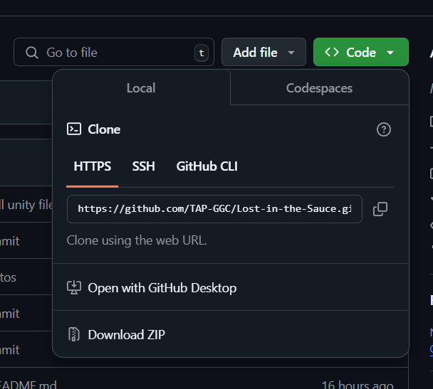

UNITY Prep / Import Game
Click this link and click the dropdown next to the green code button on the top right of the screen.
2. Next click on Download Zip on the bottom the popup shown in the previous image.
3. You should see this folder in your file explorer under downloads. Right click on it and click extract all.

Slide 3
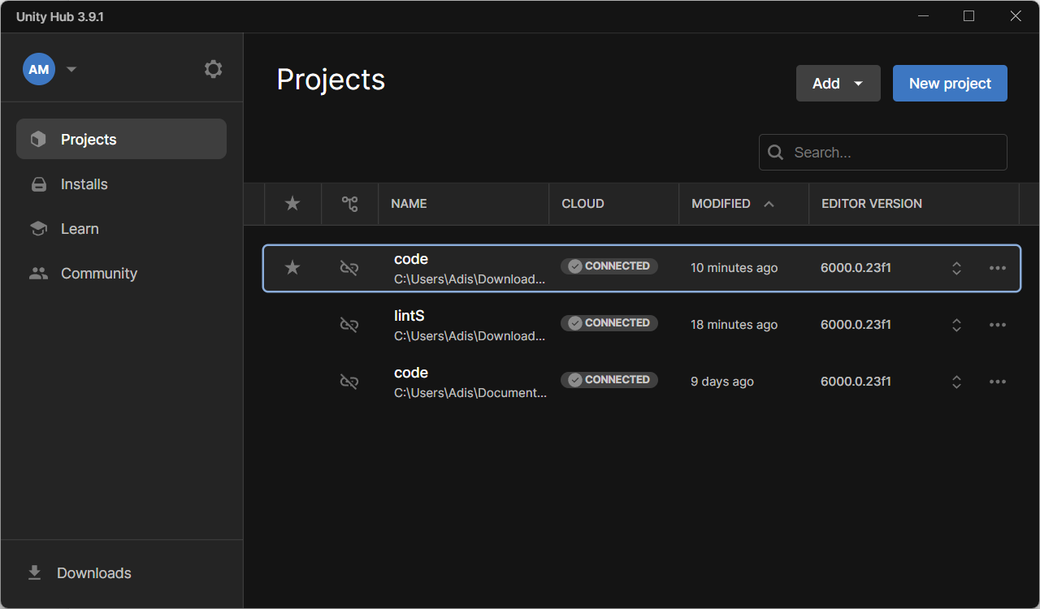
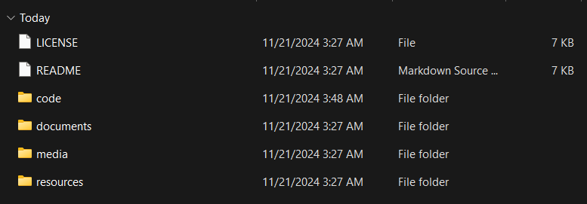
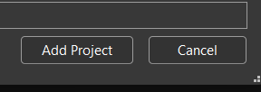
UNITY Prep / Import Game
4. Open Unity Hub and click on the Add button.
5. click on Add project from disk.
6. Find your exported file that we downloaded from GitHub earlier (should be in your downloads folder) and click on it.
7. Once in the folder click and enter the code file.
8. Click on add project

Slide 4
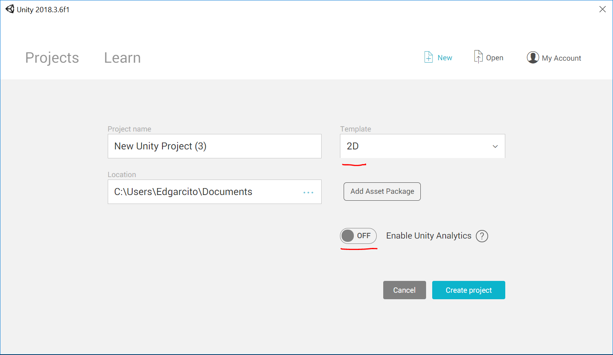
UNITY Prep / Import Game
9. Change Template to 2d and turn off Unity Analytics
10. Change Template to 2d and turn off Unity Analytics

Slide 5
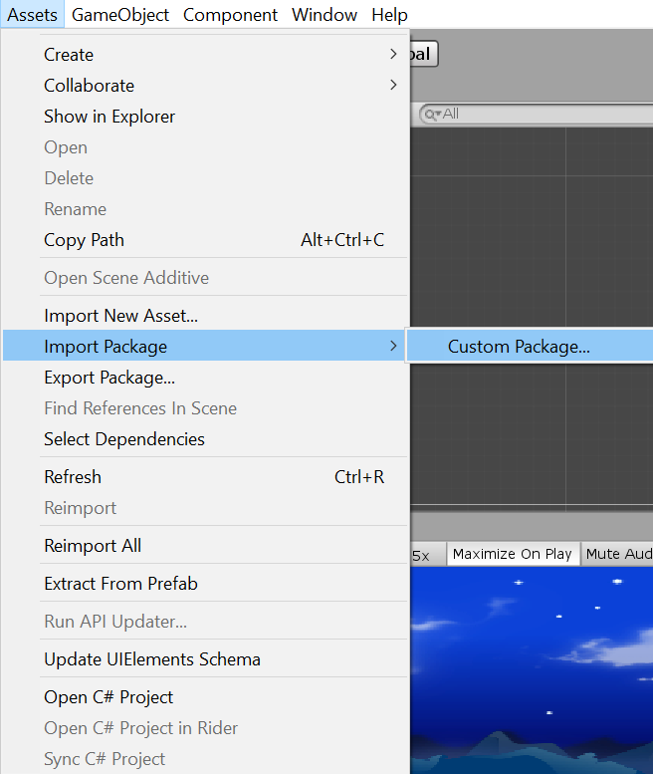
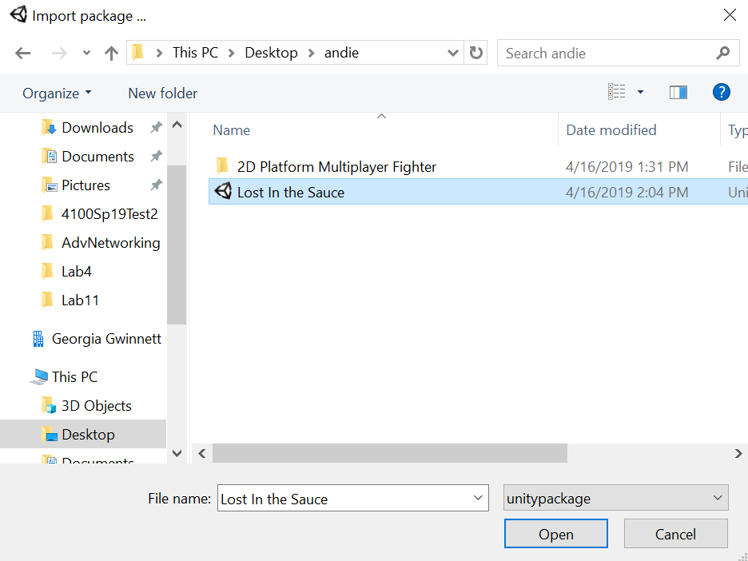
UNITY Prep / Import Game
Go to Assets Tab Under Import Package select Custom Package
2. Choose our game file that was passed via USB

Slide 6
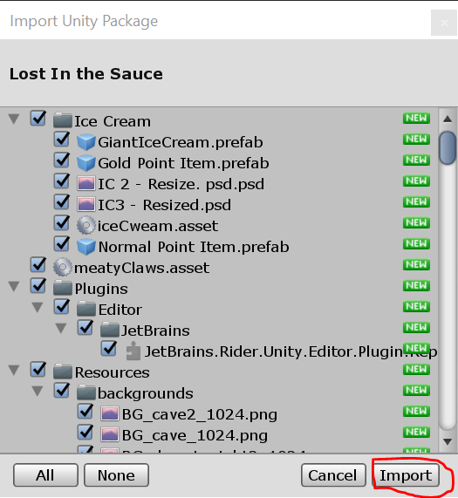
UNITY Prep / Import Game
Pop up will Show what is imported. Click Import
2. Next we Will have to Build the game. Adds Functionality

Slide 7
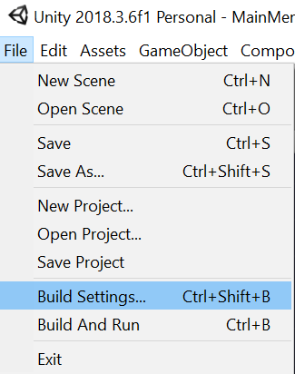
UNITY Prep / Import Game
Under File tab go to Build Settings
Or Press CTRL + Shift + B
Pop Up should appear

Slide 8
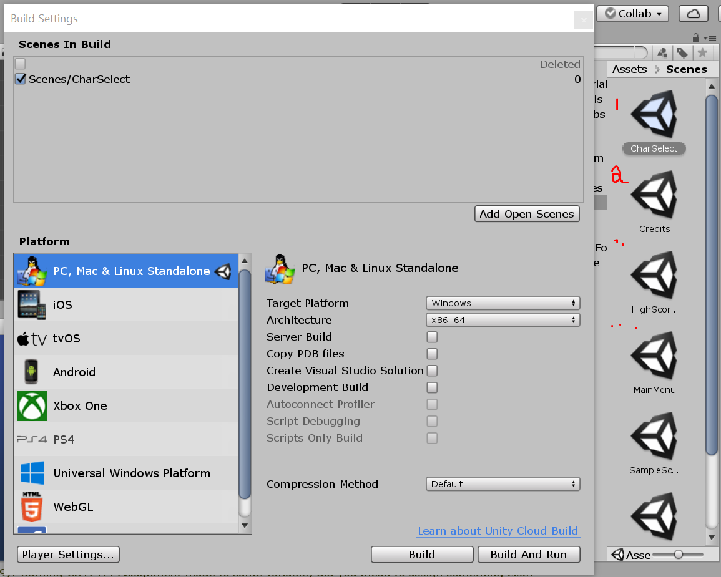
UNITY Prep / Import Game
For this Part you you will have to
change the scene by double clicking
Then click Add Open Scene
Repeat till all Scenes are in the Build

Slide 9
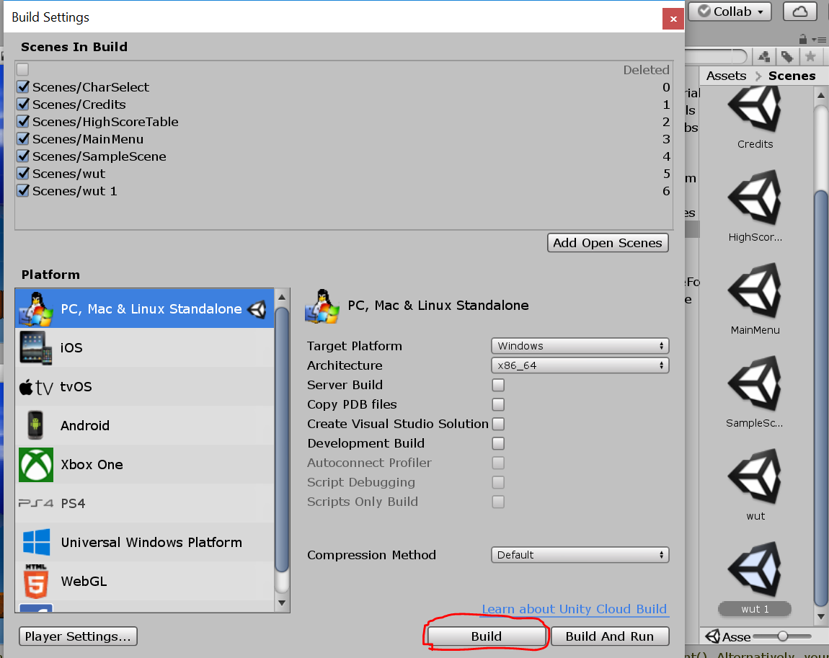
UNITY Prep / Import Game
Should Look like this:
Then click Build after all scenes are in build.

Slide 10
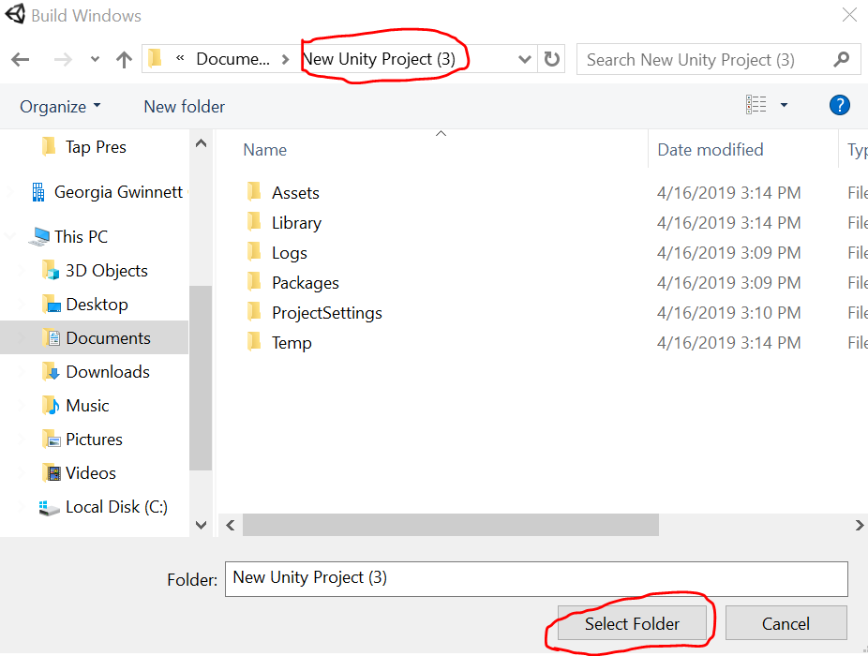
UNITY Prep / Import Game
Once you press Build this pops up.
You can just Click the folder name in the top bar.
Then press select folder to confirm.

Slide 11
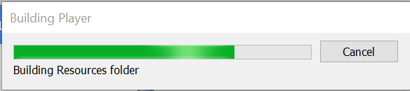
UNITY Prep / Import Game
After loading it should be ready.

Slide 12
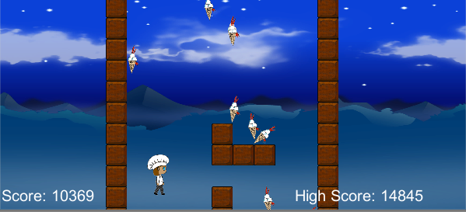
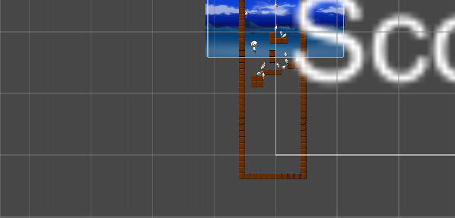
Lost in the Sauce
This game is an infinite wall jumping game where the player has to be on the wall or a platform to jump. The player must obtain as many points as possible until they fall below a certain point off the bottom of the screen.

Slide 13
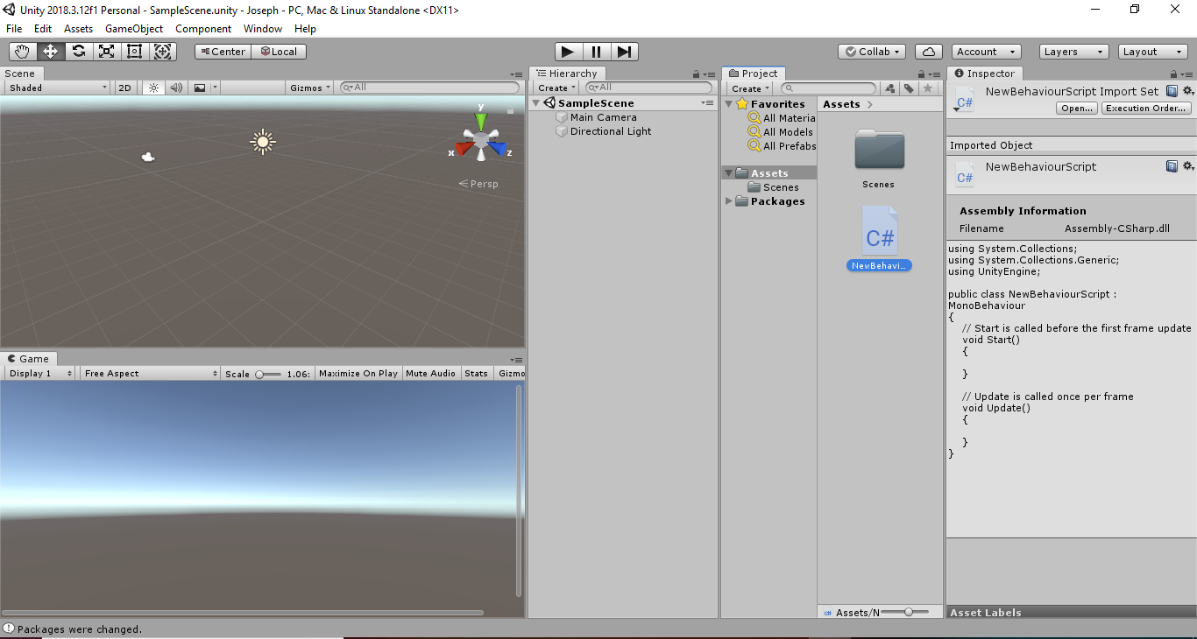
Unity Overview
Unity is a game creating engine
that provides many functions for
more easily creating games.
Drag and drop an asset into the
window to place it in the scene
Import/Export assets
Use of scripts (Programs)
Allows easy playtesting
Can modify values during test

Slide 14
Unity Overview Cont.
Can organize assets to more easily access
Can edit values inside script inside Inspector
(But not the actual Program/script)
Scripts support many predefined functions
that serve as shortcuts to make
programming certain things easier

Slide 15
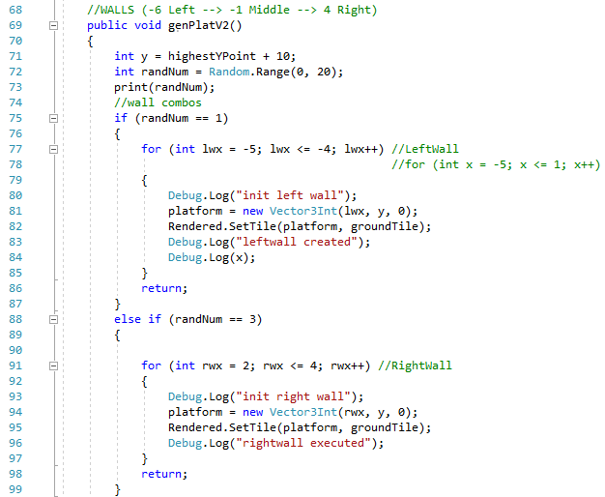
Generator
The platforms are randomly
generated based on what
number randNum is given
by Random.Range between
numbers 0 - 20
Its x coordinate will range
from -6 to 4 because that is
between the end walls

Slide 16
If Statement
Generate #
If # = 1
Build Wall Variation
If # = 2
Build Wall Variation

Slide 17
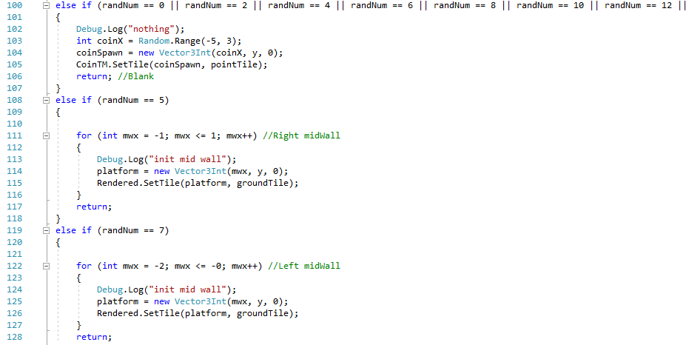
Generator Cont

Slide 18
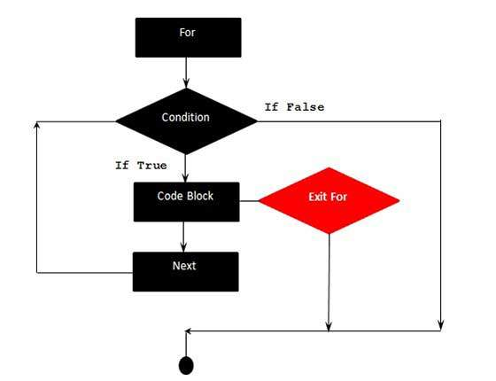
For Loops

Slide 19
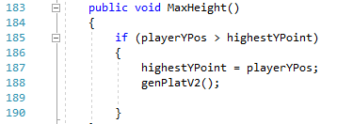
Generator Cont
The y coordinate is based
on the highest point the
player has been during
the run.

Slide 20
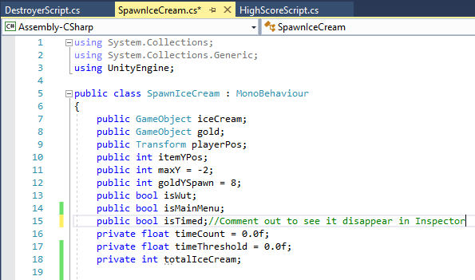
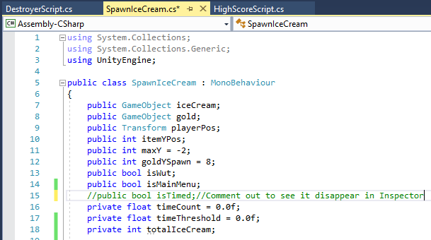
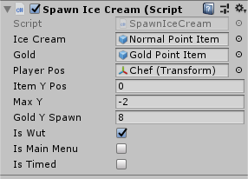
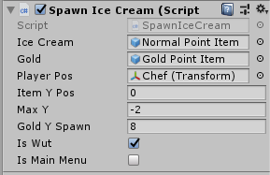
Public Values
Notes:
Public values can be changed in the Inspector. Private values cannot, as you can see the last three values which are Private in SpawnIceCream are not seen in the inspector.

Slide 21
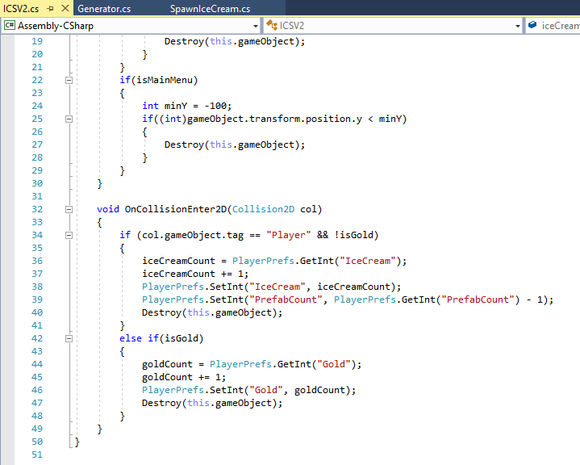
OnCollision
A premade function in
Unity
If something touches the
object, then the method
inside Collision is
triggered
Needs a Collider or
Rigidbody2D to function

Slide 22
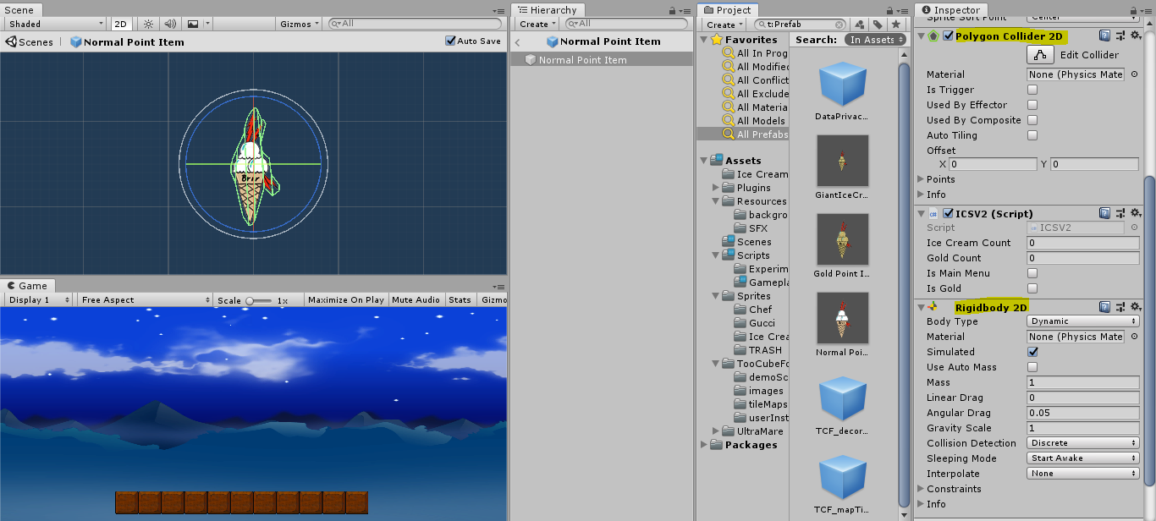
OnCollision Cont

Slide 23
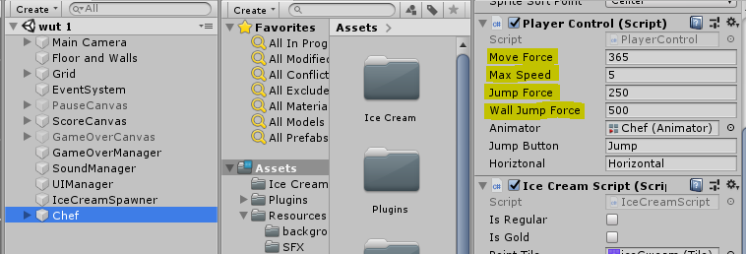
Values to Modify : Player Movement
Chef → Player Control
The Player’s movement can be
Increased or decreased by modifying
The highlighted values.
You can start by changing the
Move Force to a high value like 900,
which will make them move very fast.
You can change some of the other
Values to see what other changes will
Happen.

Slide 24
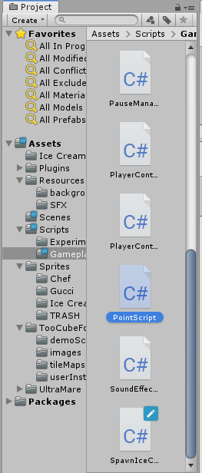
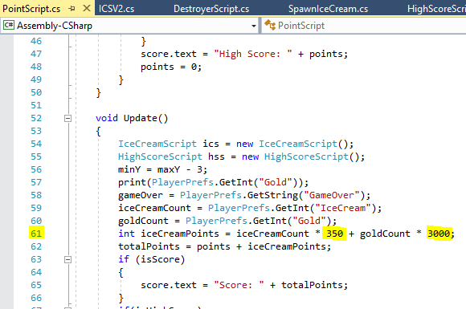
PointScript Modification

Slide 25
Changing the highlighted values modifies the multiplier for the total number of points achieved when an ice cream is collected.

Slide 26
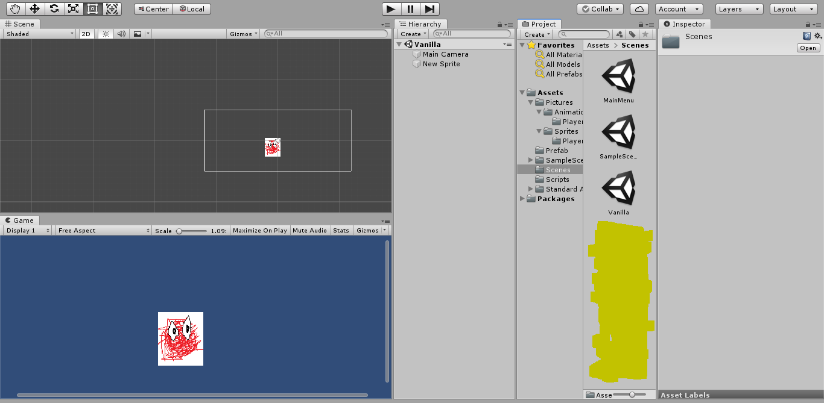
Coding
Right click in the
Highlighted area.

Slide 27
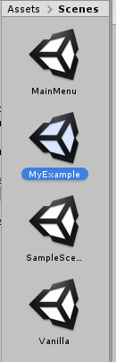
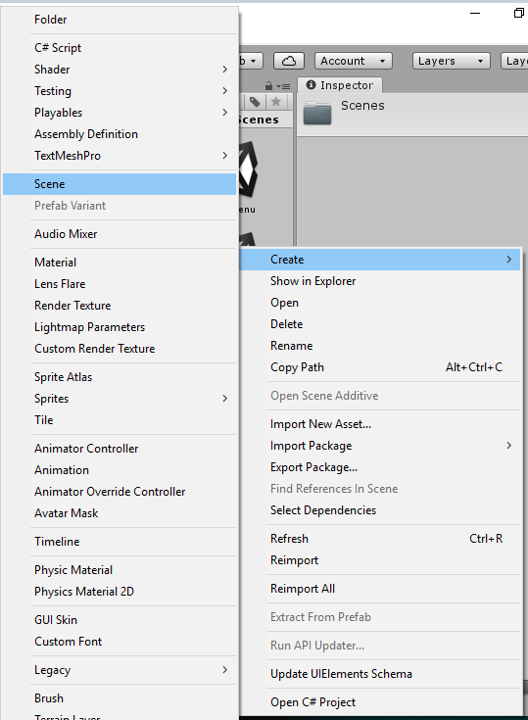
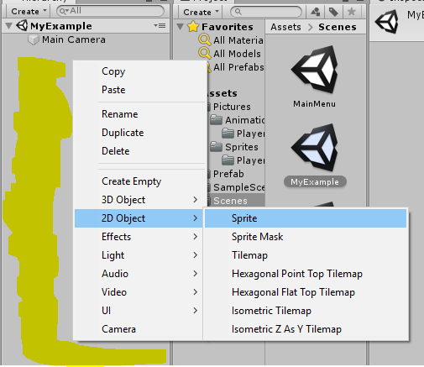
Coding Cont

Slide 28
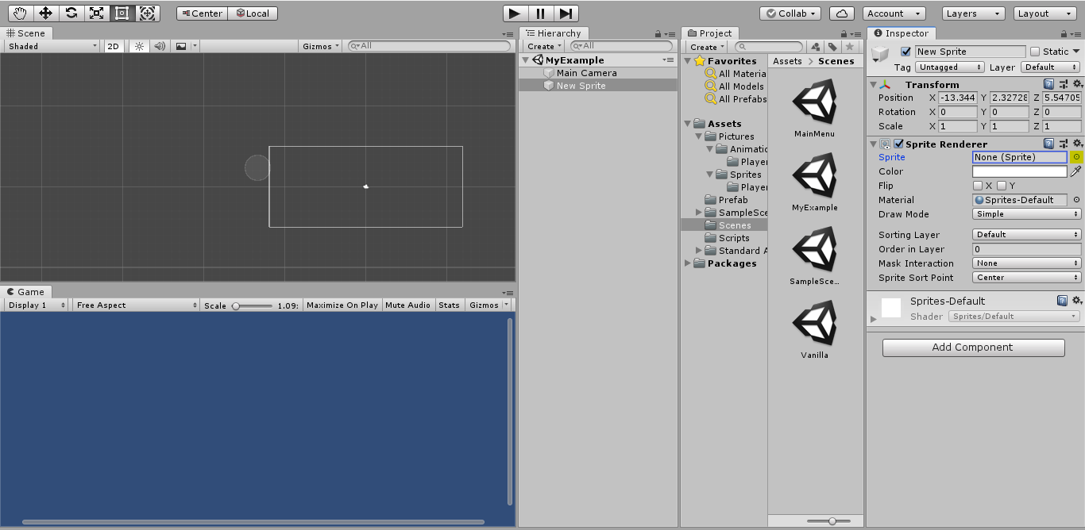
Coding: Adding a Sprite

Slide 29
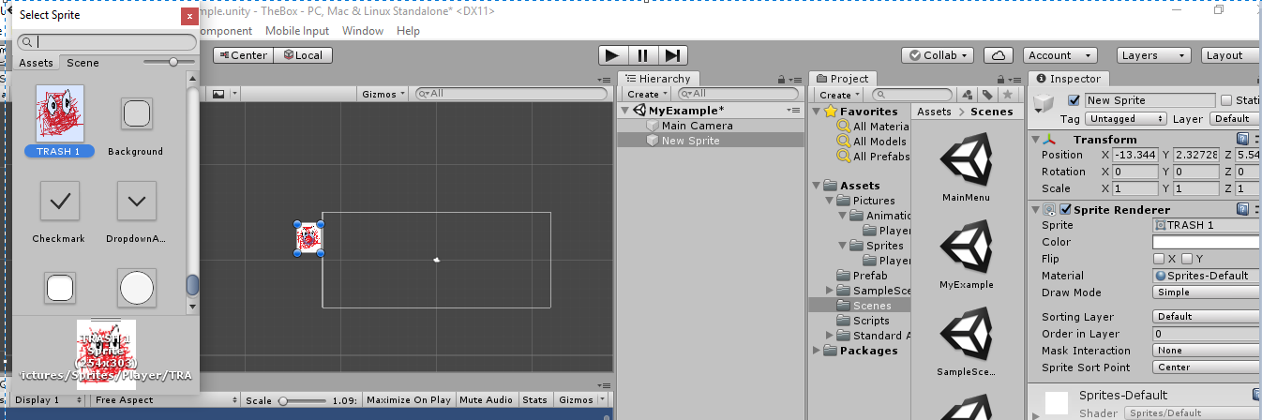
Coding: Select a Sprite

Slide 30
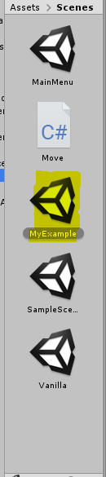
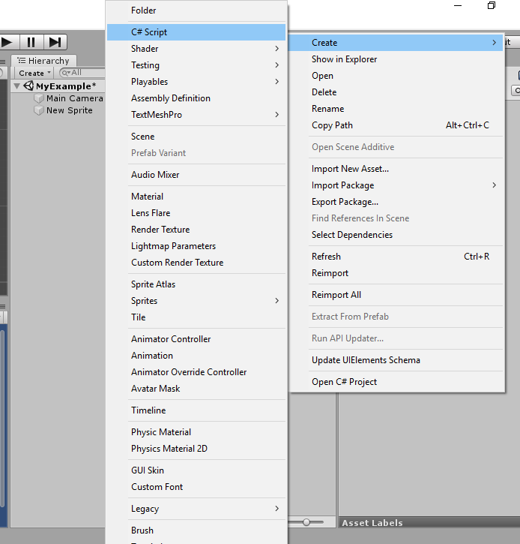
Coding: Adding a Script

Slide 31
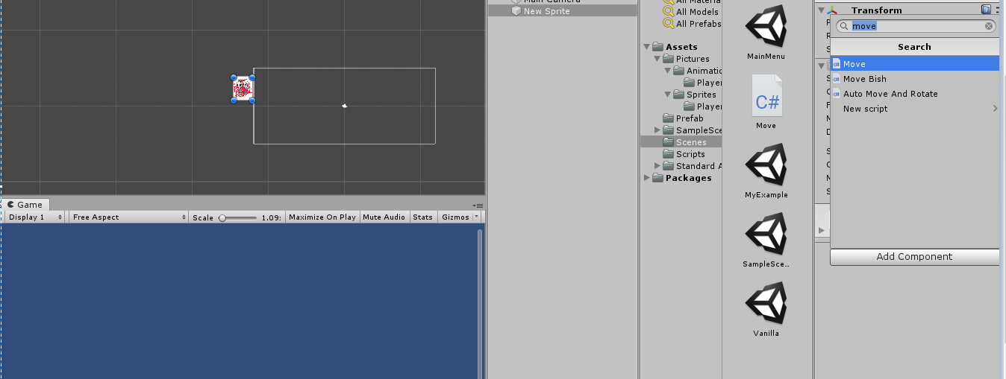
Coding: Adding in the Script to an Object

Slide 32
What will Move do?
Adding the move script to the object enables player control. Additionally, you can attach other scripts, such as collision tracking, to enhance functionality and introduce desired effects.
Create your own script and try to add it to your object. See what it does!

Slide 33
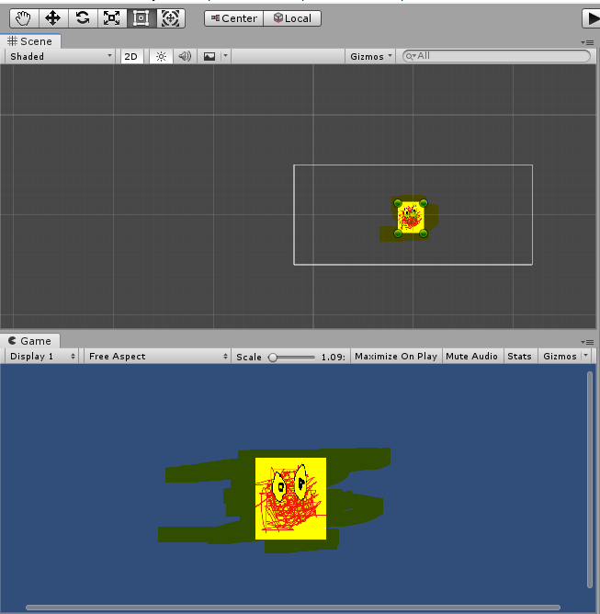
Coding: Displaced Object
Make sure your object is in the camera view. If not,
then move it into the camera view.

Slide 34
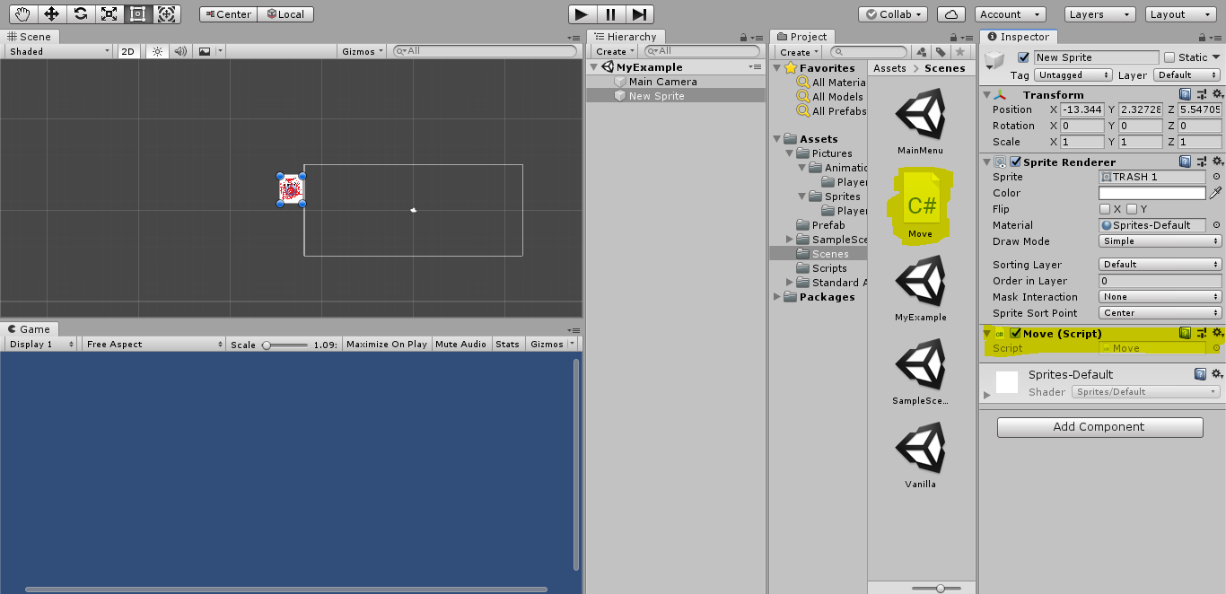
Coding: Adding the Script to an Object

Slide 35
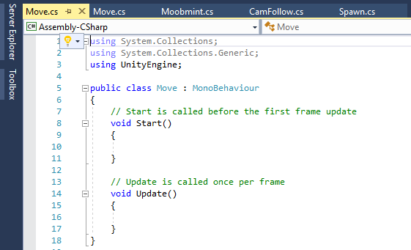
Coding: Visual Studio

Slide 36
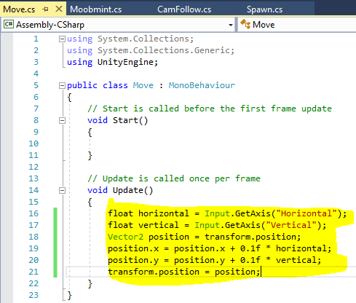
Coding: Adding Code

Slide 37
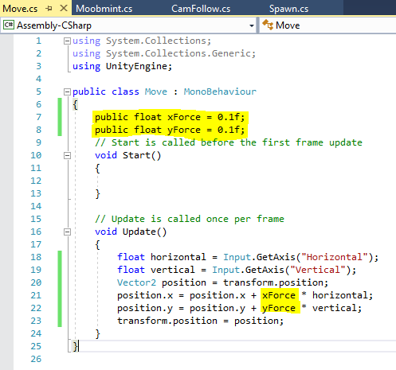
Coding: Adding Code Cont

Slide 38
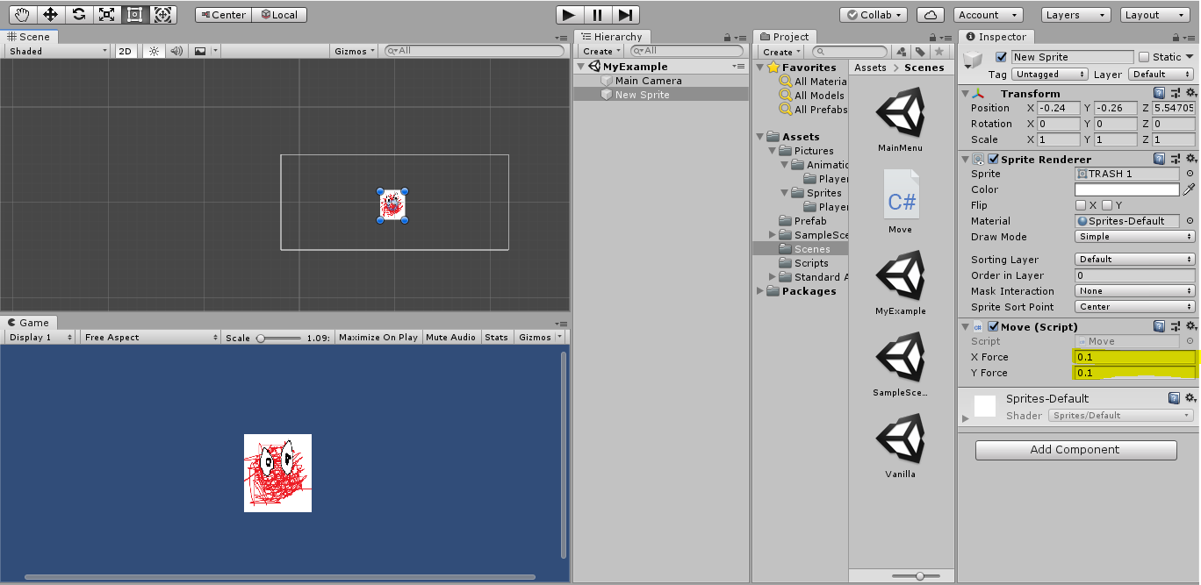
Coding: Modifiable Values

Slide 39
Summary
Unity may seem challenging at first, but with some study and preparation, it becomes an intuitive and powerful game development tool. *Lost in the Sauce* serves as a helpful template for learning Unity and C#, giving users the confidence to create their own games.
Lost in the Sauce GitHub

